Slide 1
The Word who is Life
Vision for Mission
Resources for Reflection

Slide 2
Mission
“All authority in heaven and on earth has been given to me. Go, therefore, make disciples of all the nations; baptise them in the name of the Father and of the Son and of the Holy Spirit, and teach them to observe all the commands I have you. And know that I am with you always; yes, to the end of time.”
Mt. 28:16-20

Slide 3
The Church receives the mission of proclaiming and establishing among all peoples the kingdom of Christ and of God, and she is, on earth, the seed and the beginning of that Kingdom.
Lumen Gentium, n. 5

Slide 4
The Church on earth is by her nature missionary since, according to the plan of the Father, she has as her origin the mission of the Son and the Holy Spirit. The ultimate purpose of mission is none other than to make all share in the communion between the Father and the Son in their Spirit of love.
CCC. n.850

Slide 5
It is from God’s love for all that the Church in every age received both the obligation and the vigour of her missionary dynamism, ‘for the love of Christ urges us on’.
CCC. n.850

Slide 6
The Holy Spirit is the protagonist…so the Church, urged on by the Spirit of Christ, must walk the road Christ himself walked, a way of poverty and obedience, of service and self-sacrifice even to death, a death from which he emerged victorious by his resurrection.
CCC. n.852

Slide 7
All Christ’s faithful have the obligation and the right to strive so that the divine message of salvation may more and more reach all people of all times and all places.
c.211.

Slide 8
All of us are called to take part in this new missionary “going forth”. Each Christian and every community must discern the path that the Lord points out, but all of us are asked to obey his call to go forth from our own comfort zone in order to reach all the “peripheries” in need of the light of the Gospel.
Evangelii gaudium, n.20.

Slide 9
The Diocese
A Diocese is a portion of the people of God, which is entrusted to a Bishop to be nurtured by him, with the cooperation of the presbyterium, in such a way that, remaining close to its pastor and gathered by him through the Gospel and the Eucharist in the Holy Spirit, it constitutes a particular Church. In this Church, the one, holy, catholic and apostolic Church of Christ truly exists and functions.
c. 369

Slide 10
Mission: All in the Diocese are called to be disciples and all, by virtue of their Baptism, to be engaged in the task of bringing others to know Christ.
Prayer: The life of the People of God is centered in the Eucharist. through the Eucharist, the other Sacraments and through prayer, we are nourished for the work Christ has given us to do.
Formation: We must, too, be formed for this work – without formation, we shall be able neither to deepen our own relationship with Christ, not be his instruments for others.

Slide 11
We have one subject only:
“Something which has existed since the beginning, that we have heard, and we have seen with our own eyes, that we have watched and touched with our hands, the Word, who is life – this is our subject”
1 Jn.1:1

Slide 12
The Times in which we live
We are living in the time of the ‘New Evangelisation’ – a time when we must be open to the voice of the Holy Spirit, that the unchanging message of the Gospel be brought to a world that is in great need.
We do have the gifts and talents for this task, but the demands are great and we need to re-structure in order to fulfil the work we have be given.

Slide 13
Looking to the Future
In order for us to foster prayer, develop formation and ensure continuing mission, we must review our Diocesan and Parish life.
This must be carried out at a time when the ratio of priests to people of changing.
This will be challenging for all concerned and difficult decisions must be made.

Slide 14
Current Statistics
Catholic Population (estmated) | 160,000
Mass Attendance | 39,340
Number of Parishes | 85
Number of Churches | 128
Number of Priests serving in parishes | 92
Ratio of Priests to People:
Catholic Population | 1:7739
Mass Attendance | 1:427

Slide 17
In 2030
The Diocese will have 50 priests
Of whom 25 will be under 65
Ratio of Priests to People:
  Catholic Population 1:3200
  Mass Attendance 1:787

Slide 18
Questions
Given the Mission to which we have all been entrusted, what three things do you think we most need for Mission-effectiveness?
What roles in this Mission can be best carried out by the lay-faithful?
What factors, do you think, have brought abut the present situation that we are having to address in our Diocese?
If we were starting the Diocese today, with 25 priests, where would you place them?

Slide 19
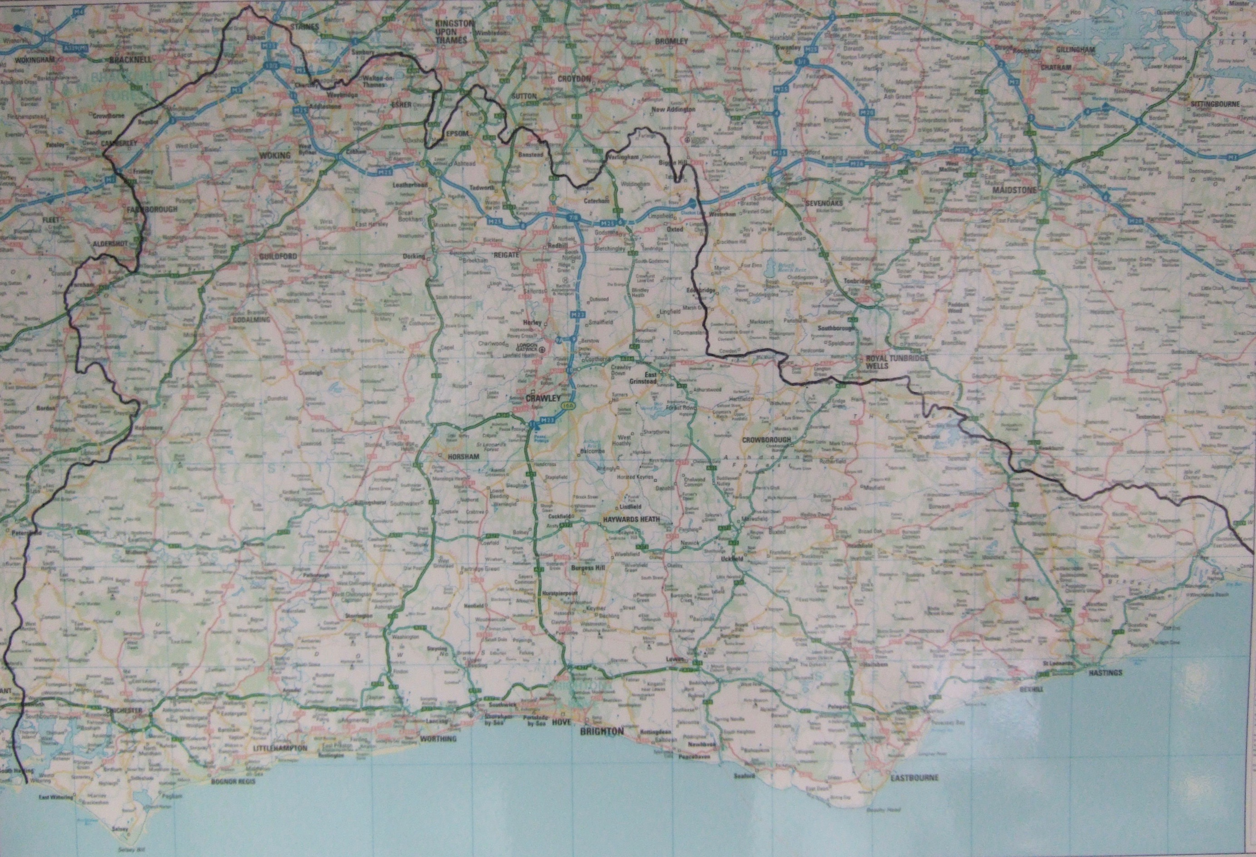
The Diocese

